Slide 1
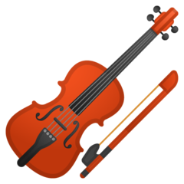


Instrument Your Life

Slide 2
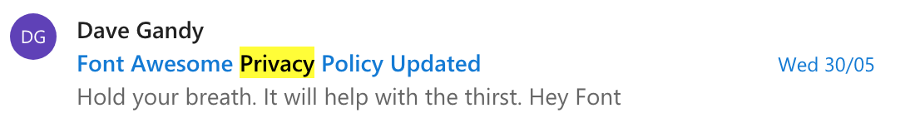
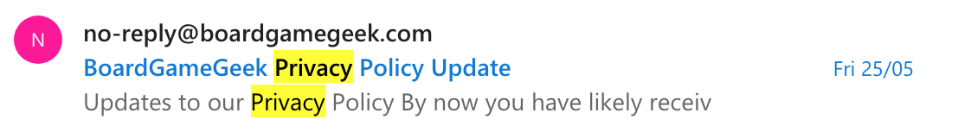
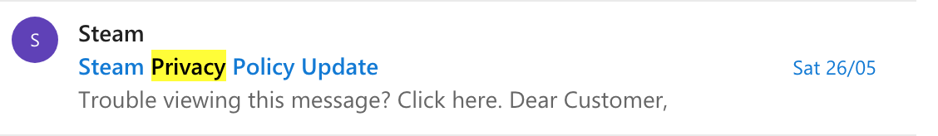
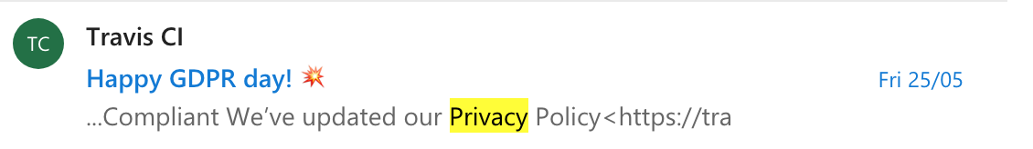
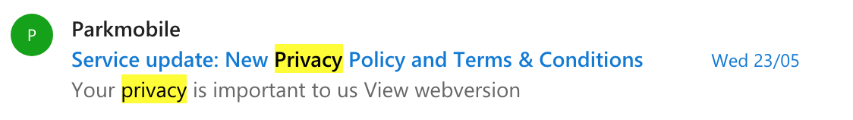
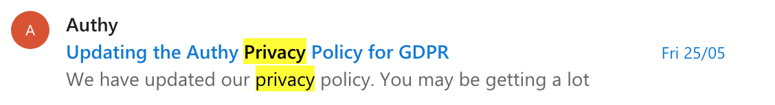
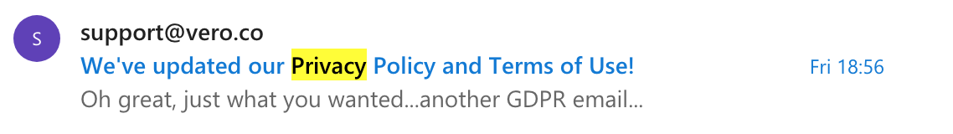
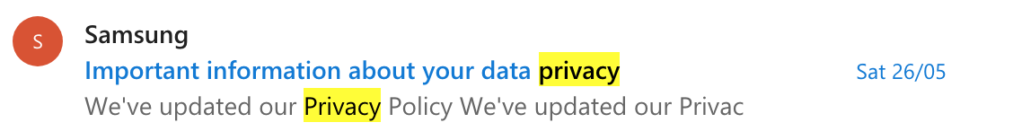
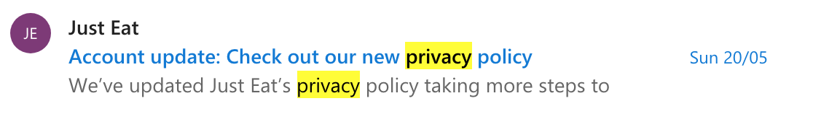
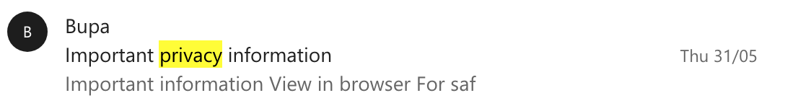
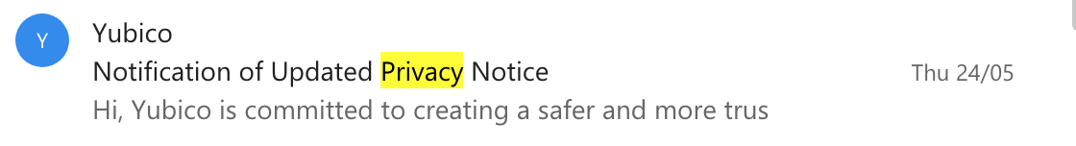
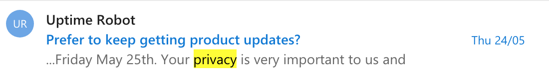
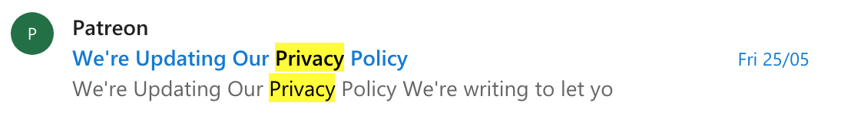
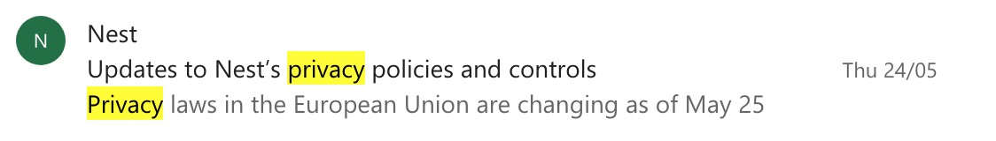
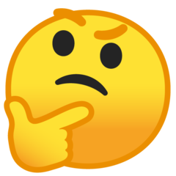
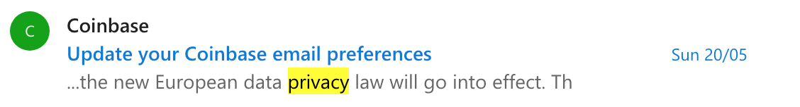
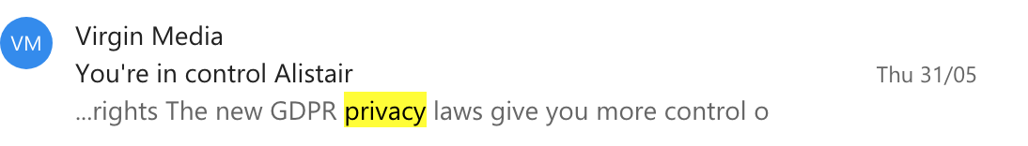
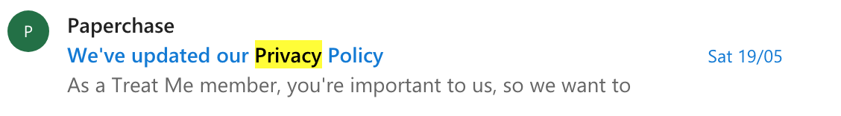
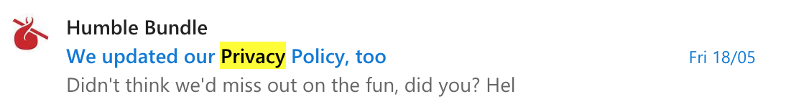
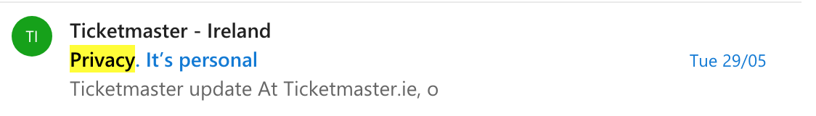
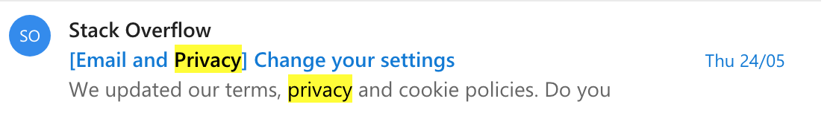
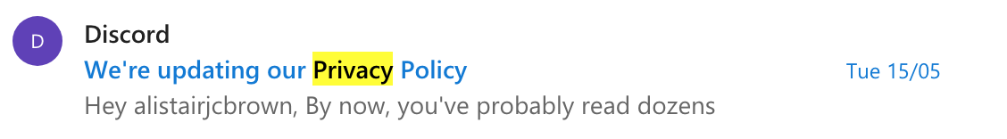
GDPR
Notes:
I think we’ve all seen the GDPR emails recently
Wow, I have a lot of accounts
What data do they have?

Slide 3


Who am I?
Alistair Brown Lead Engineer @ ShopKeep Building things with JavaScript for the last 7 years
twitter.com/alistairjcbrown
github.com/alistairjcbrown
keybase.io/alistairjcbrown
Notes:
I’m Alistair - I work at ShopKeep where I mostly do things with JavaScript.
Yes - that means I’m probably the least qualified person to talk to you about dealing with large amounts of personal data.

Slide 4

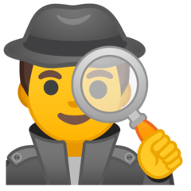
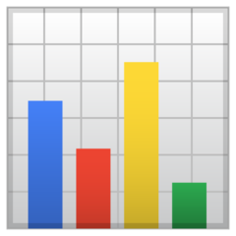
Disclaimer
This won’t give you a profound understanding of me, yourself or the world
Nothing to do with data privacy (my data’s all on Github)
All the data is real - I’ll try my best not to show anything too sensitive
Notes:
Talk disclaimer
I don’t think this will blow your mind - there’s not some secret pattern to the universe that this will uncover - I’m setting my bar at mildly interesting
And also, all of this data is real - mostly because I’m too lazy to create fake data - so I’ll try not to show anything too sensitive, and no judgement

Slide 5

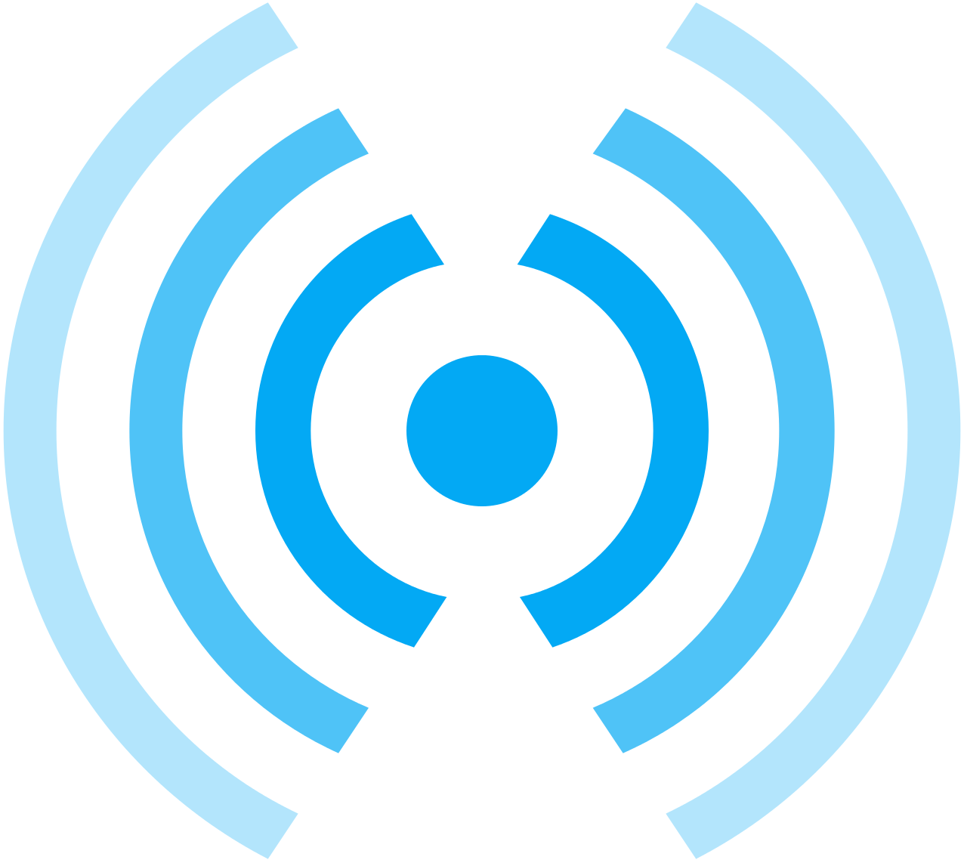
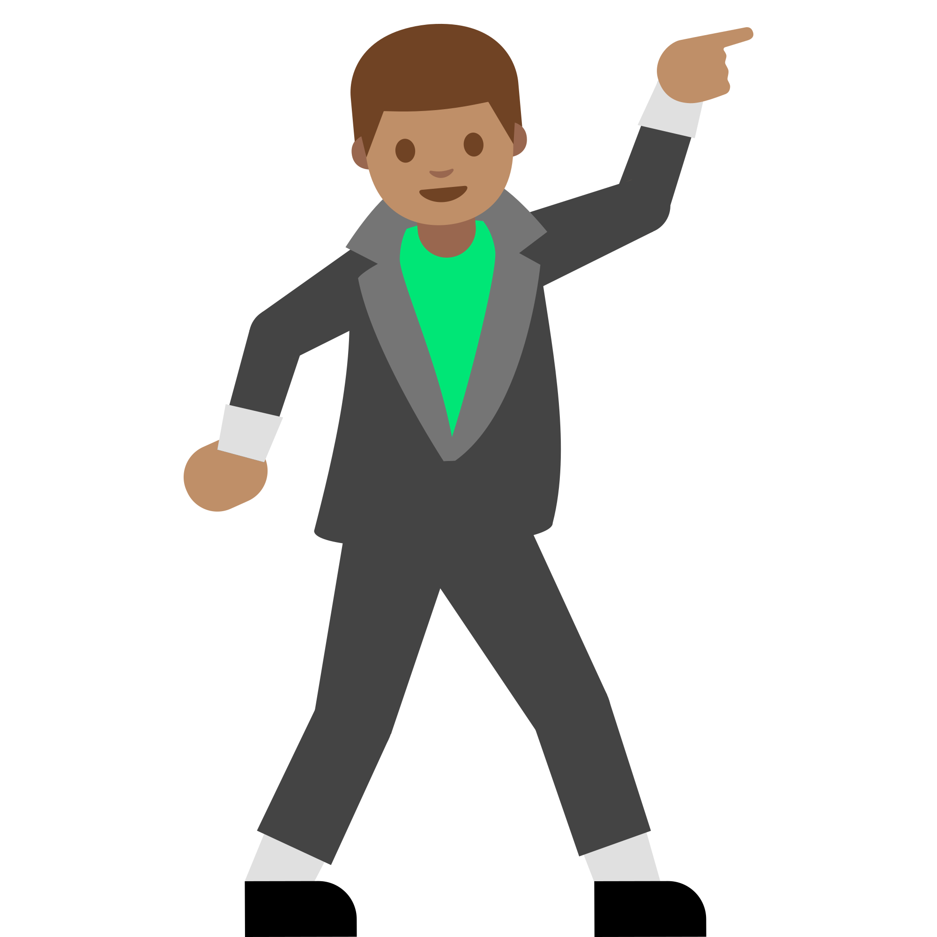
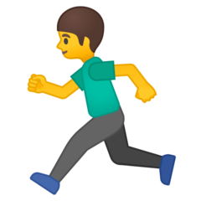

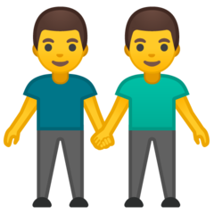


Human Broadcasts
Where have I been?
How active am I?
What have I watched?
Who did I meet?
What did I eat?
How was my day?
Notes:
Just by existing, we generate state and put information out into the world

Slide 6

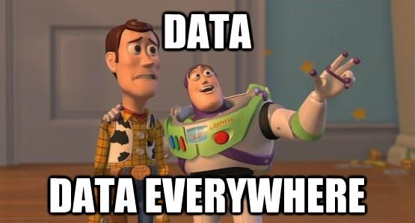
Notes:
There’s so much data

Slide 7



There’s data, so what?
“Every day that goes by, data is lost” ~ Hugh Glaser
How do we capture it?
How do we use it?
Notes:
Back at university, Hugh was one of my lecturers. In the days before smartphones with GPS, he wore a GPS tracker strapped to his arm.
“Every day that goes by, data is lost” - and it’s true. All of the data we emit into the world, unless there’s something to capture it, dissipates.
So, the first question - how do we capture it? And then, once we’ve got the the data, how do we use it?

Slide 8
Instrumentation
Instrument equip (something) with measuring instruments.
.Instrument everything . as much as we can
.Instrument everything .
Notes:
If you were instrumenting a piece of code, you’d have it trigger events for different code paths, you’d pull the output logs, you’d get data from the environment around it for resources it’s using. You’d know everything that the system was doing, all of the time.
We instrument everything now, so we can figure out what questions need answered later
But humans and the world around us are far too complex to pull all data - so we need to figure out what we can get our hands on

Slide 9
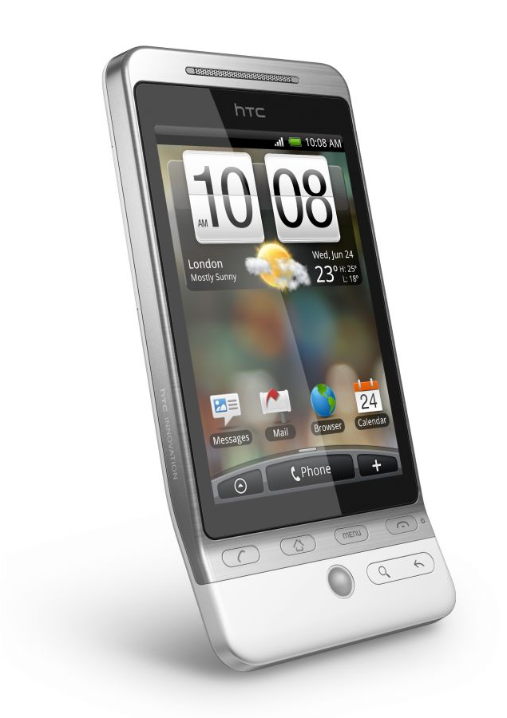

The year is 2010...
Challenge: “Record everything you consume”
Notes:
The year is 2010
I wanted an interesting data set to potentially play with, so I set myself the challenge of recording everything I consumed.
Twitter still felt new,I still wasn’t sure why it existed, and so armed with my trusty HTC hero, I used twitter as my dumping ground for data.

Slide 10
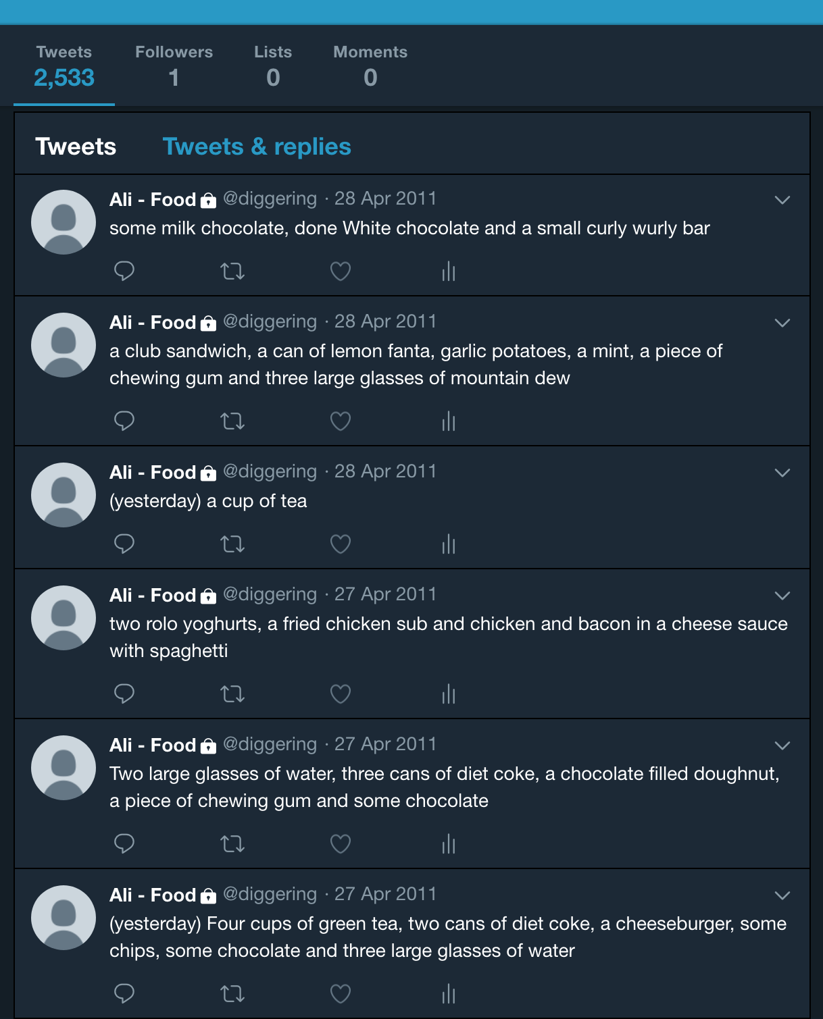
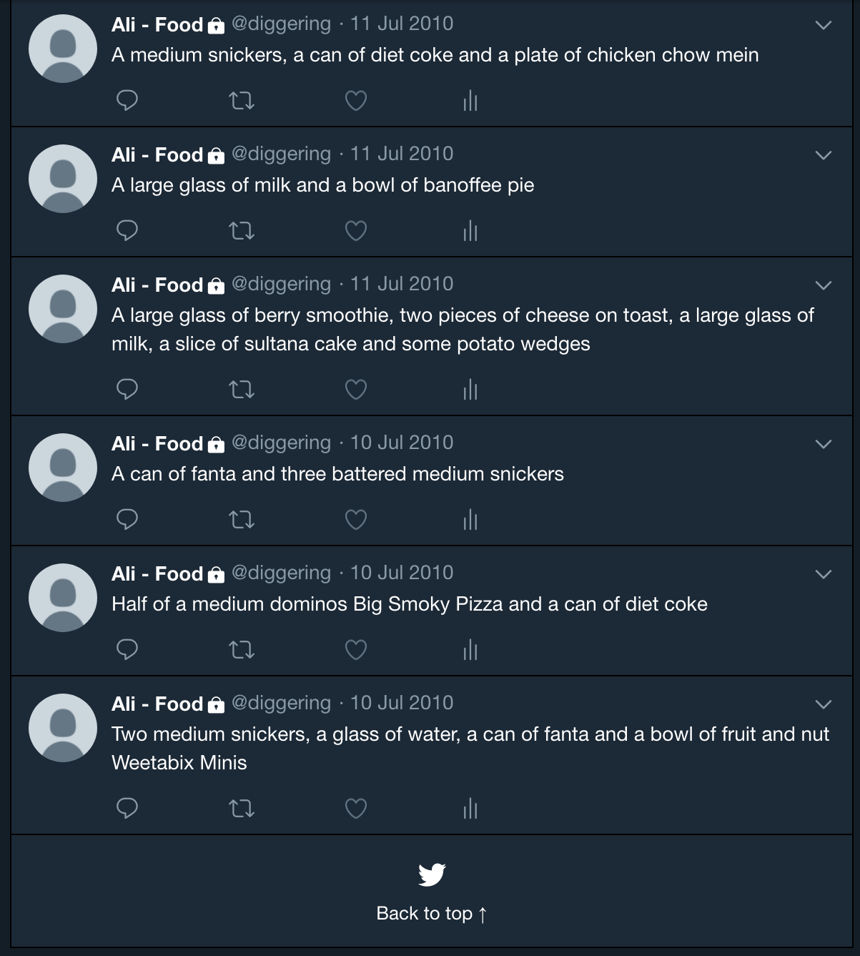
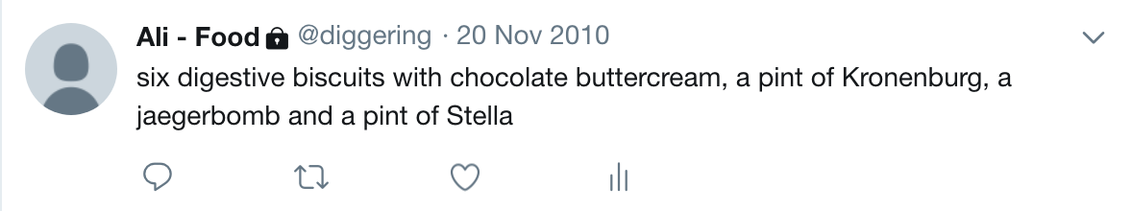
Notes:
And this is what we go: 2,533 tweets, over a 9 month period from July 2010 to April 2011
I was meticulous; I recorded everything
And I learnt 2 things
The people around you hate it when you stop every time you eat something so you can write it down
Manual data entry isn’t sustainable
This tweet was my favourite - a sneak peek into my student life, 20th November 2010 was the time to be alive.

Slide 11
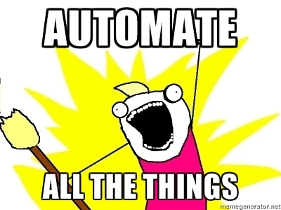
Notes:
So I managed 9 months before I gave up. I’ve tried it again since with MyFitnessPal, Fitbit - I really want to log this information
But it only ever worked short term - the effort involved in writing in all that information, scanning barcodes, finding approximations - it’s not sustainable.
We need to automate instrumentation if it’s to work at a larger scale.

Slide 12
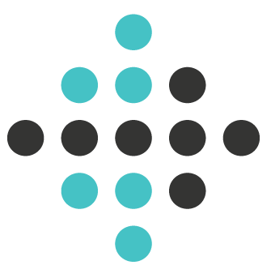

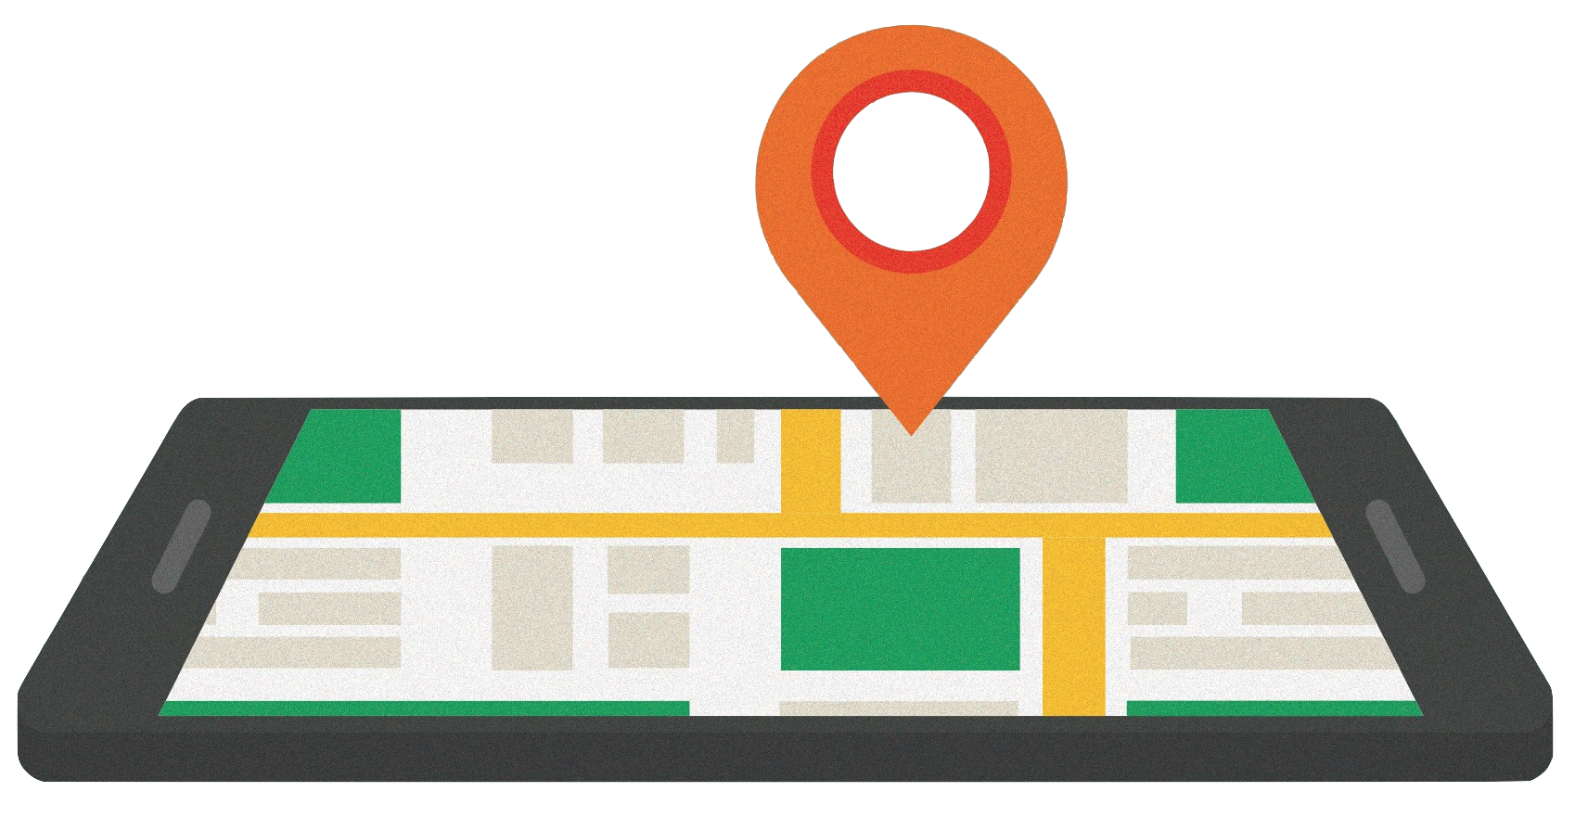
Automation
What can I get for minimal effort?
Where have I been?
How active am I?
What have I watched?
Notes:
So, what can I get for minimal effort?
I use an android with location services enabled - this gives me data on where I visit and when
I wear a fitbit which gives me step count, heart rate, sleep patterns, etc. - I find times when I’m not doing anything to charge it so i don’t lose any important data
I can grab some viewing habits from Netflix - I’ve a shared account, by we can make that more accurate by filtering out shows watched when I’m not home

Slide 13



What about uncaptured data?
Who did I meet?
What did I have for lunch?
How was my day?
What was the weather like?
Was Github down?
Did we meet our team goals?
Notes:
Some things we can’t automatically capture
We’ve just gone through some of the difficulties in recording consumption, but anything not automatically recorded falls into this same need for manual recording.
Something things we may be interested in capturing, but they’re not specifically about us.
Context data can be very powerful for providing better insight into data about ourselves. However, this falls into the complexity issue - we can’t instrument everything in the world around us.

Slide 14



Manual
What can I get for minimal effort?
How was my day?
Notes:
Same question as automation - “what can I get for the minimum amount of effort?”, though that effort will probably be more than the automated solution
What is the minimum I would require for this?
Just need to ask myself this question at the at the end of each day.
Keep the input simple so it can be done quickly. 3 options - good, neutral and bad
No context, no supplementary information, just a simple status
Disclaimer: I’ve only been doing this for about 4 months - it’s nice to have the data, though I’m not sure a simple status is enough context. But - it’s an experiment, so I’ll give it a bit more time and see what other data I can mash with it

Slide 15
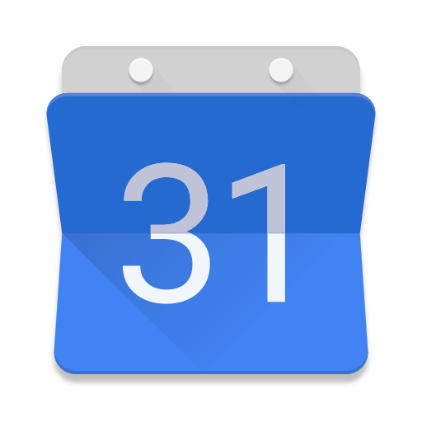
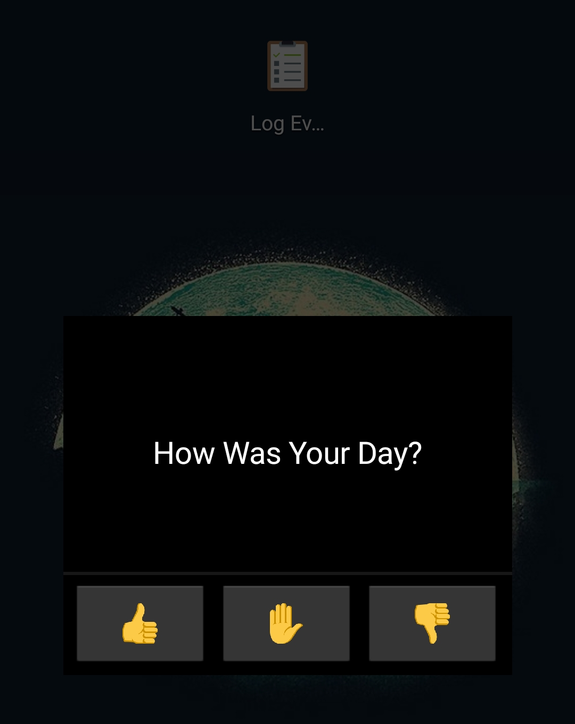

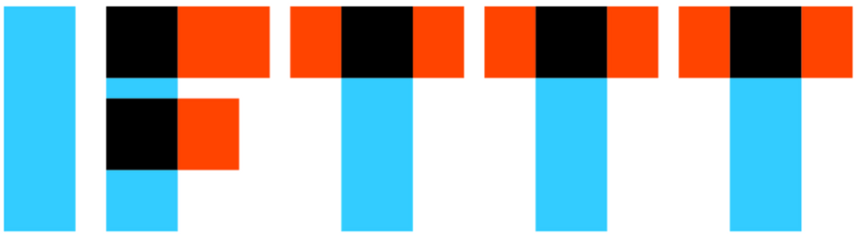
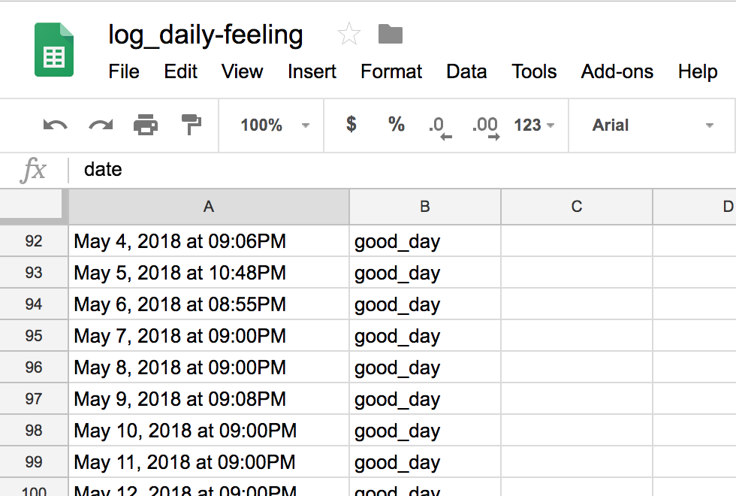
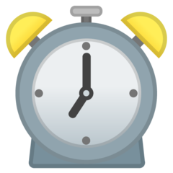

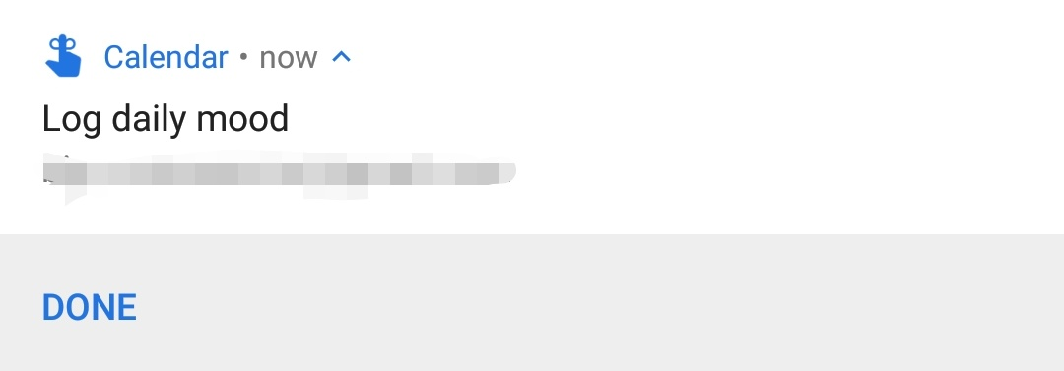
Notes:
Google calendar for reminder, which reminds me each evening
Tasker for UI - launches a popup from a widget on the home screen
Select whether it was a good day, neutral or bad from the icons
Tasker task makes HTTP call to IFTTT endpoint with the corresponding value
IFTTT adds the entry to a specific Google sheet with a timestamp, for storage

Slide 16
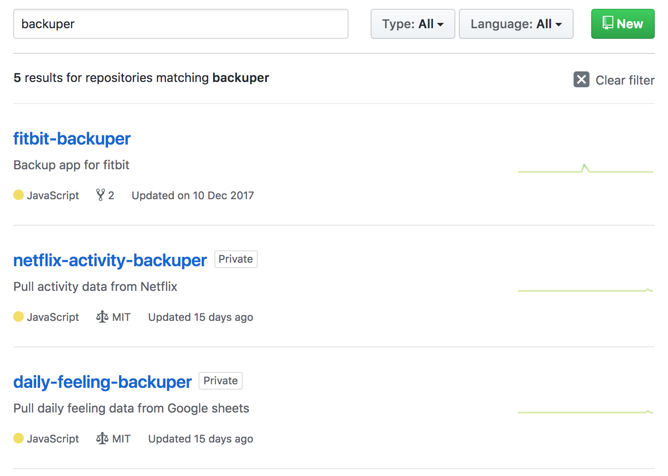
Data Hunting
Notes:
Fitbit has an API - I automatically pull all data each night and push to a private Github repository
Netflix don’t have an API
But they do have an endpoint to power their UI which lists what you’ve previously watched
I have a script to page through the data from that endpoint and split by day
Google sheets has an API
I have a script to pull the data out into JSON
Google Timeline allows you to export KML
I have a script to pull the data out
There’s also Google’s takeout service
The location data from this is super raw - I periodically grab takeouts, but I’m not yet sure what to do with the raw co-ordinate data
Currently I’m still playing - but I’ll aim to open these repos up soon!

Slide 17
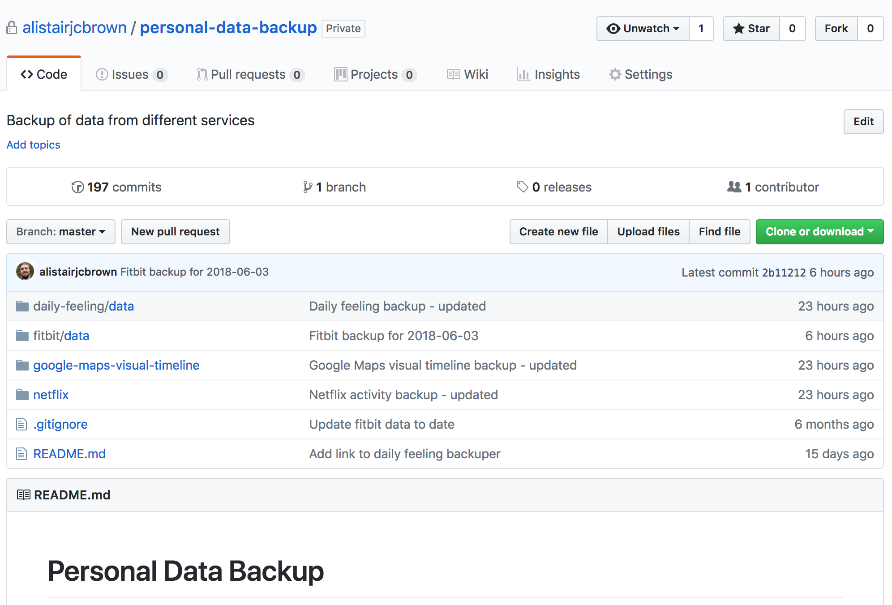
Notes:
All of that tooling is to pull data into this private repo.
This is my single source of truth for my instrumentation data
I like git as a place to store text files, and provide access to changes (caveat, I’m not sure how it scales to large numbers of text files)
Github provides easy hosting and allows me to hook nightly runs in, so they can automatically push data into this repository. YMMV depending on how much you trust Github with this kind of data.

Slide 18
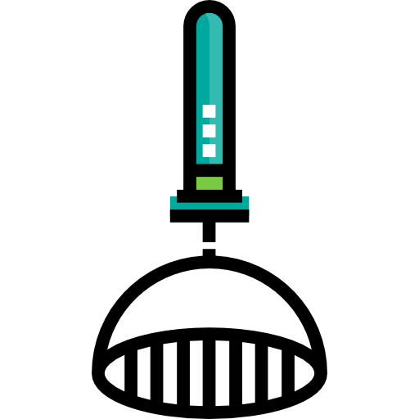
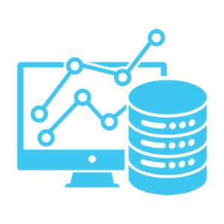
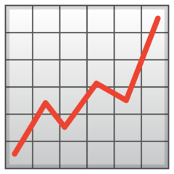
Mash it all together
What can we learn? Can we built context?
Interrogate a single date in time
Look for trends across date ranges

Slide 19
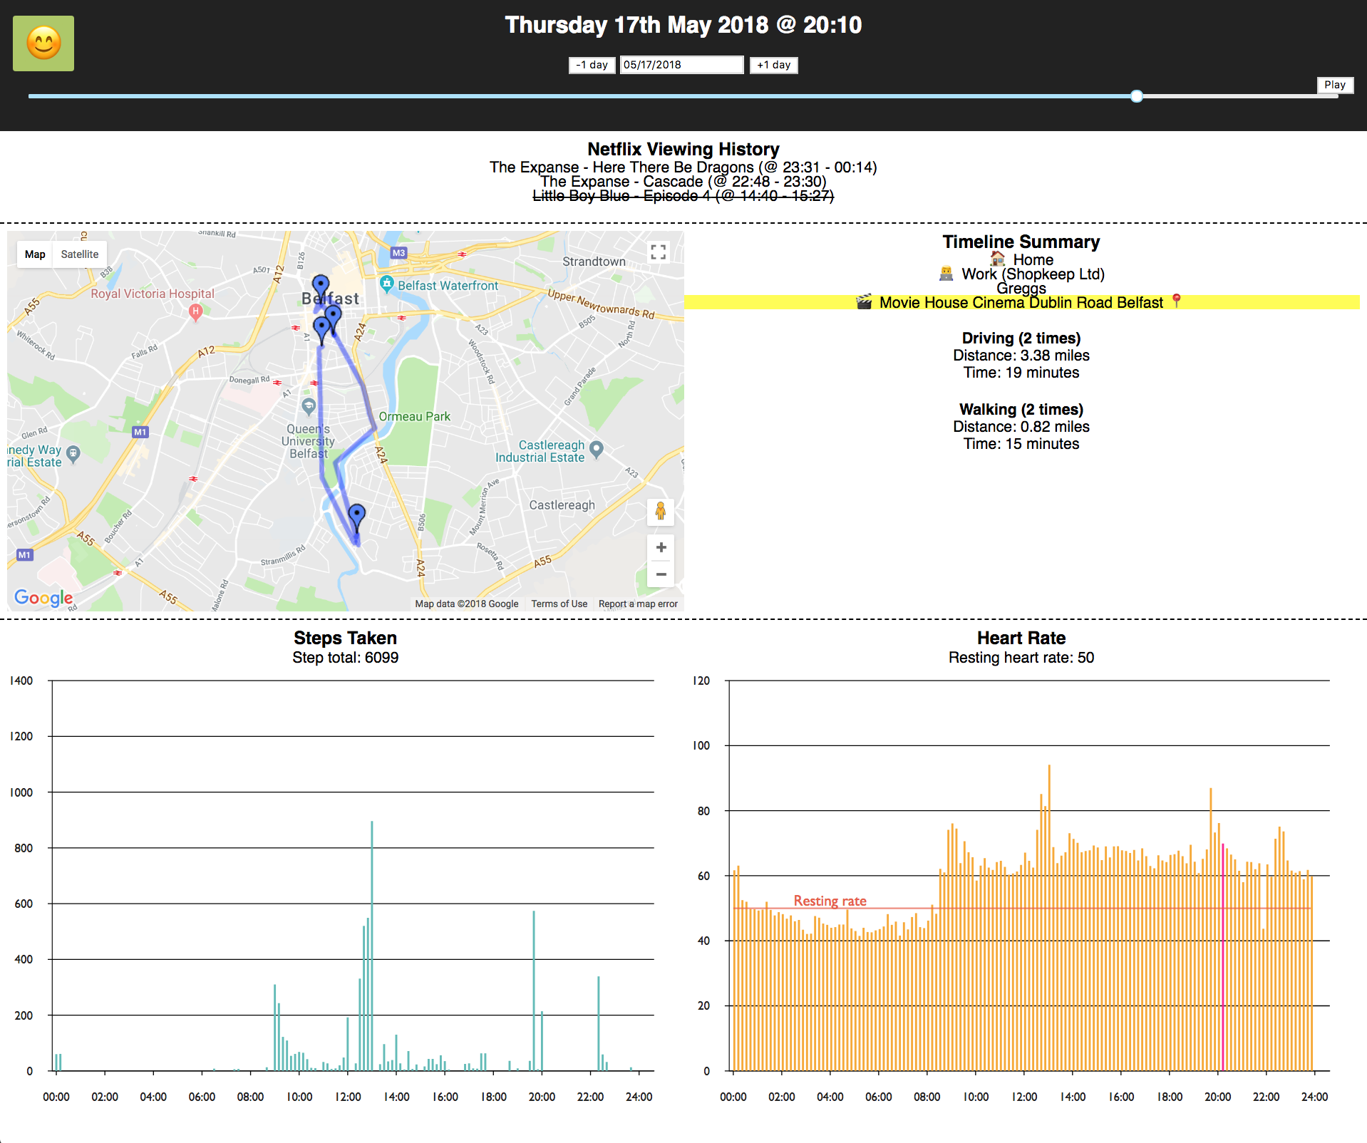

Live Demo Time

Slide 20
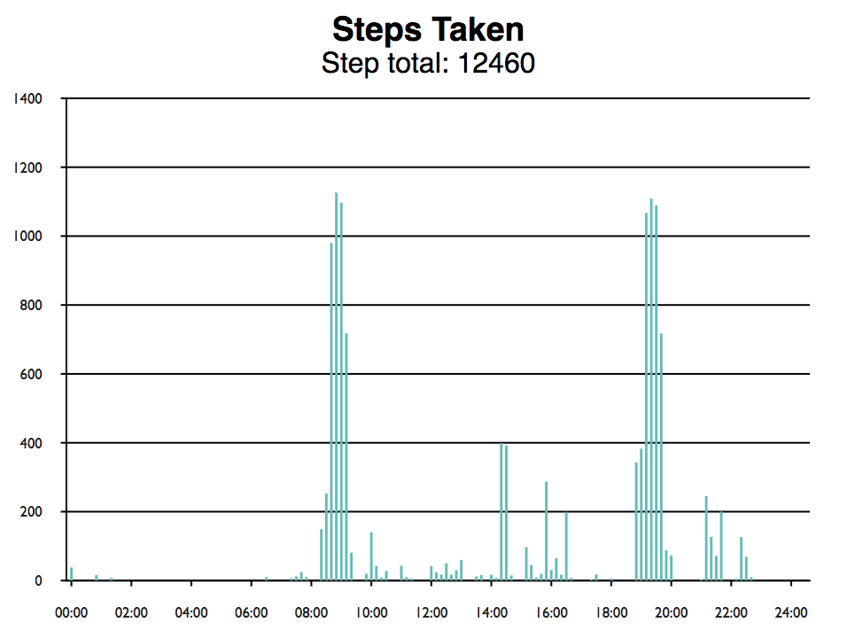


Friday 1st June 2018
How active am I?
Heart rate spikes. Why?
Notes:
Start off with an easy example -

Slide 21



Monday 5th March 2018
How active am I?
Higher resting heart rate (60). Why?
Average resting heart rate: 48 - 52
Where have I been?

Slide 22




Saturday 10th March 2018 & Monday 30th April 2018
How active am I?
Where have I been?

Slide 23





Wednesday 13th December 2017
Heart rate spikes just before midnight. Why?
Opportunity for new data source?

Slide 24




Pulling out Trends
How long did it take me to watch a series on Netflix? When did I generally watch it?

Slide 25


Mood over the last few months?
Notes:
Generally happy, a cluster of neutral moods at the end of February. A few days either side of the line was when I was in Canada - I was there for a funeral. Interesting to see how it affected my mood and pushed on into mid March.

Slide 26



How often do I not leave the house?

Slide 27


How often do I buy coffee?
Notes:
Based on being in a Caffe Nero, Starbucks, or any location with coffee in the name, like the Vietnamese coffee shop

Slide 28
What do you want to know?
Where have I been?
How active am I?
What have I watched?
Notes:
So that was my data - what’s yours? Put it to work - what do you want to know?

Slide 29



What do you want to know?
Where have I been?
How active am I?
What have I watched?
What have I listened to?
What have I watched?
Notes:
Hook music players to last.fm
Hook video players to track.tv

Slide 30



What have I bought?
https://monzo.com/blog/2018/06/07/monzo-on-ifttt/
Notes:
Pay for things with something like Monzo for bank analytics

Slide 31





What do you want to know?
Teeth brushing?
Who did I meet?
How often do I make tea?
Notes:
Use an iKettle to boil water
Bluetooth toothbrush?
Known people in your house using router device list
(IoT for the win)

Slide 32






What do you want to know?
Did I take medication?
How often am I at my desk?
Did I walk the dog?
Which room am I in?
Notes:
Log other events (medication, walking dog, etc.) - NFC stickers can help
Bluetooth beacon for tracking local movements?

Slide 33

Inspiration

Slide 34





Top Tips
Check how accessible the data is - clean API or screen scraping?
Get the easy data first and play with it - low hanging fruit!
Check what’s out already there - don’t reinvent the wheel!
Keep manual instrumentation small - use helpers to keep on top it
Keep all the raw data - you’ll never know what might come in handy!
Notes:
I’ll finish off with some top tips!
(reminders, nfc stickers, etc.)
Automate the bits that are effort (recommend Tasker) - Lower the barrier to entry

Slide 35

Notes:
I still want to figure out a good way to log what I eat - maybe in the future I’ll be able to just snap a photo and have it figure it out

Slide 36




Notes:
Machine learning for the win? But maybe we’re not quite there yet!

Slide 37



Thank you for listening Any Questions?

